Slide 1
TOURISIM ACTIVITY ANALYSIS

Slide 2
PROBLEM STATEMENT
Tourism managers need to make the strategic plans for the tourist and take important decisions to recommend activities to the tourist to improve tourist satisfaction, which isn’t that easy as it seems.
On the other hand, running restaurants, cafes, malls, dessert shops isn't always as charming as first impressions appear. There are often all sorts of unexpected troubles popping up that could hurt business.

Slide 3
SOLUTION
If we can analyze the pattern of activities at various restaurants, malls, dessert shops, etc. preferred by different tourist groups( Asian, European, North American, Oceania) in Bangkok, this can support the tourist managers to recommend places and make strategic plans for them.
Furthermore, If we can analyse how many customers to expect at different points of time in each day, then stores can accordingly purchase ingredients and schedule their staff members.
This forecast isn't easy to make because many unpredictable factors affect stores attendance, like weather and local competition. It's even harder for newer stores with little historical data.

Slide 4
EXISTING SYSTEM
[1] Huy Quan, et al. "Tourist activity analysis by leveraging mobile social media data." presented a new approach to travel diary construction based on the venue check-in data available in mobile social media with rich information on locations, time, and activities. Our case study focuses on the inbound tourism in Hong Kong using a data set composed of 17,355 check ins generated by 600 tourists.
[2] Huy Quan, et al. "Exploring tourist dining preferences based on restaurant reviews.“ in their paper presented a method that utilizes online restaurant reviews and text processing techniques in analyzing the dining behaviors of tourists. The effectiveness of the proposed method is demonstrated in a case study on international tourists visiting Australia using a large-scale data set of more than 40,000 restaurant reviews made by tourists on 2,265 restaurants.

Slide 5

SYSTEM DESIGN
STEP 1: Web Crawling
STEP 2: Data Collection
STEP 3: Data Pre-processing
STEP 4: Exploratory Data Analysis and Forecasting
STEP 5: Final Results and Analysis

Slide 6
IMPLEMNTATION: Data Collection
Traditional approaches to construct travel diaries usually require direct contact with tourists. Participants are required to manually record their journey and experiences using various media, such as paper, video, online blogs, and GPS loggers. This process is time-consuming and captures limited information
While this article attempts to introduce mobile social media in constructing travel diaries in order to capture travel and contextual information reflecting tourist activities. We presented a method to extract Foursquare check-in data and to collect travel information without directly engaging with tourists. The data contained information on the visited locations, temporal behaviors, and activities of tourists.
We have extracted the tweets of the foreign twitter users which are integrated with the Swarm check-in application. Using these tweets for each user they have created an itinerary of the list of places the user visited while his/her trip to Bangkok.
As of now, we have collected the data for about 120 tourist users, with total of 2000 check-ins.
The Data collection process has two major steps:
User identification
Travel Dairy Construction

Slide 7
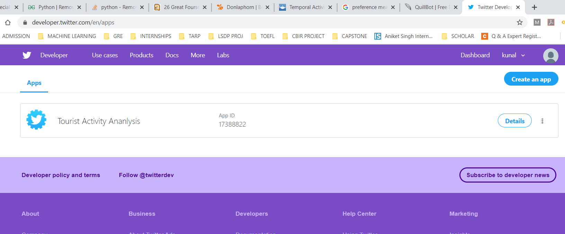
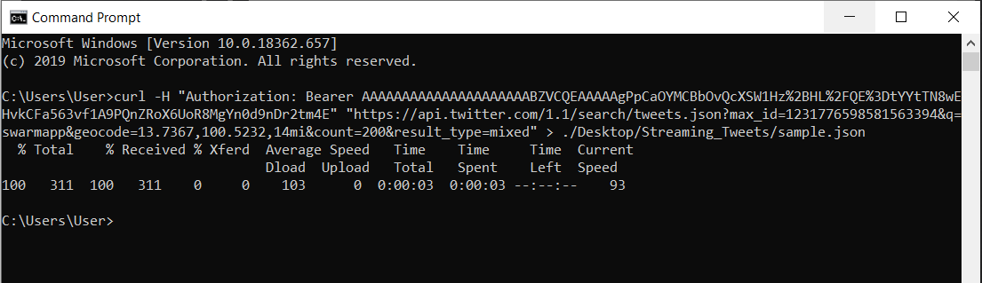
1. USER IDENTIFICATION PROCESS
STEP 01: Create an App using Twitter Developer Account.
STEP 02: Using the app extract the tweets uploaded using swarm app in Bangkok and save it in a json file.

Slide 8
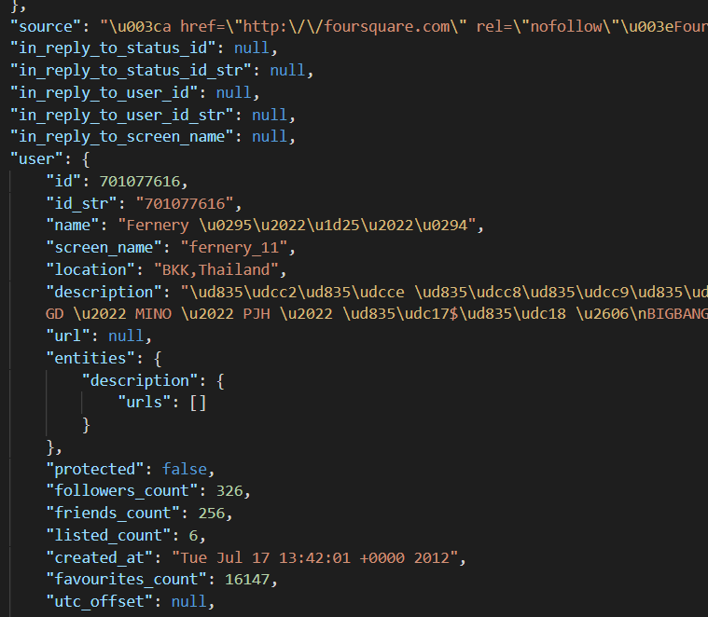
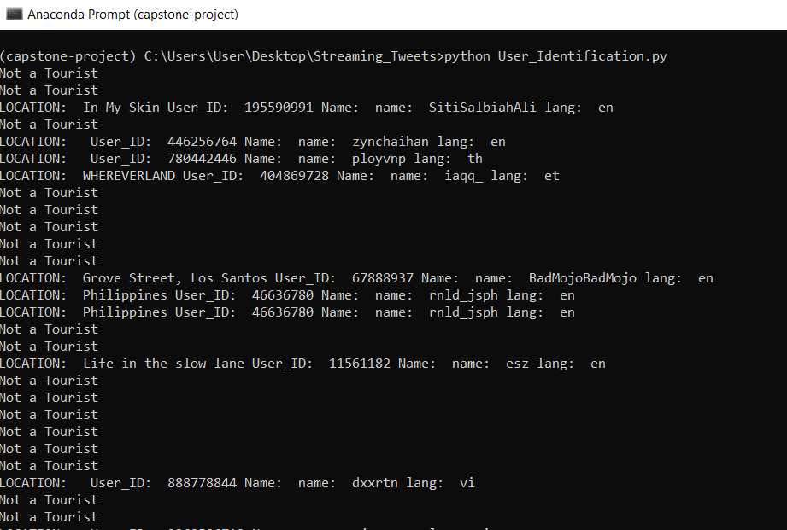
1. USER IDENTIFICATION PROCESS
STEP 03: From the extracted tweet extract the home location of the user.
STEP 04: Use Regex model to automate the process of identifying the check-ins uploaded by foreign tourist.

Slide 9
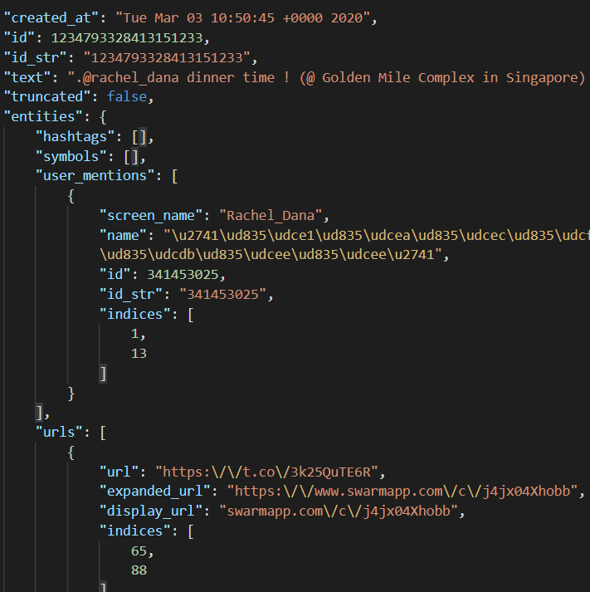
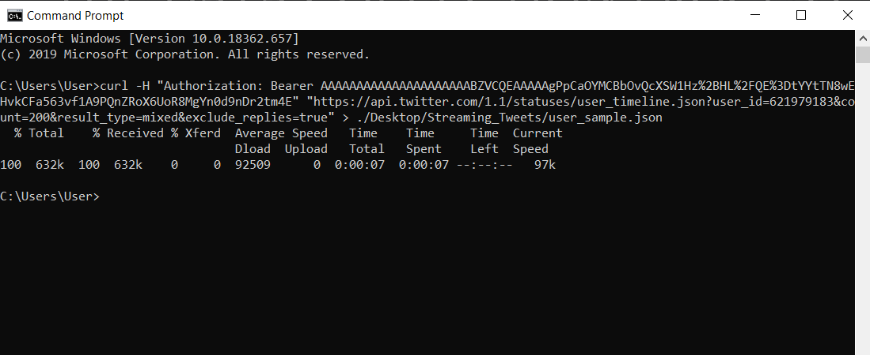
2. TRAVEL DAIRY CONSTRUCTION
STEP 05: For each tourist user extract the user’s timeline to find out all the check-ins uploaded by the user.
STEP 06: Extract the check-in date and time from each tweet as well as the expanded url.

Slide 10
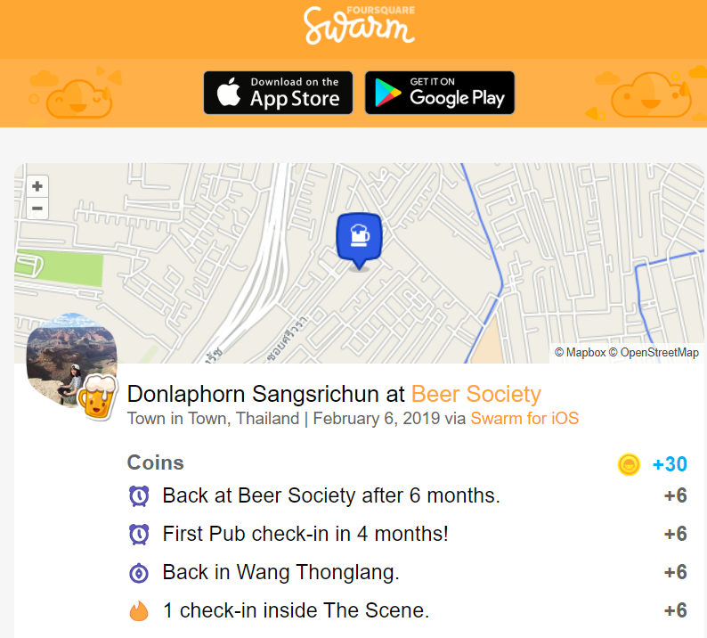
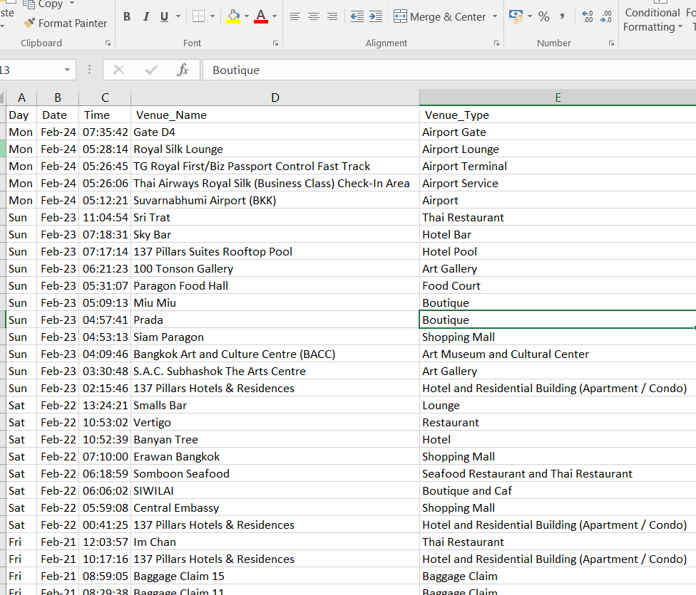
2. TRAVEL DAIRY CONSTRUCTION
STEP 07: Using the expanded URL mention in the tweet scrape the Venue Name and Venue type from the webpage.
STEP 08: Save the Date, Time, Venue Name and Venue type into a data frame and covert it to csv file to construct the travel dairy.

Slide 11
Example of Travel Diary Constructed for a User from Tokyo, Japan
Day | Date | Time | Venue_Name | Venue_Type
Mon | Feb-24 | 07:35:42 | Gate D4 | Airport Gate
Mon | Feb-24 | 05:28:14 | Royal Silk Lounge | Airport Lounge
Mon | Feb-24 | 05:26:45 | TG Royal First/Biz Passport Control Fast Track | Airport Terminal
Mon | Feb-24 | 05:26:06 | Thai Airways Royal Silk (Business Class) Check-In Area | Airport Service
Mon | Feb-24 | 05:12:21 | Suvarnabhumi Airport (BKK) | Airport
Sun | Feb-23 | 11:04:54 | Sri Trat | Thai Restaurant
Sun | Feb-23 | 07:18:31 | Sky Bar | Hotel Bar
Sun | Feb-23 | 07:17:14 | 137 Pillars Suites Rooftop Pool | Hotel Pool
Sun | Feb-23 | 06:21:23 | 100 Tonson Gallery | Art Gallery
Sun | Feb-23 | 05:31:07 | Paragon Food Hall | Food Court
Sun | Feb-23 | 05:09:13 | Miu Miu | Boutique
Sun | Feb-23 | 04:57:41 | Prada | Boutique
Sun | Feb-23 | 04:53:13 | Siam Paragon | Shopping Mall
Sun | Feb-23 | 04:09:46 | Bangkok Art and Culture Centre (BACC) | Art Museum and Cultural Center
Sun | Feb-23 | 03:30:48 | S.A.C. Subhashok The Arts Centre | Art Gallery
Sun | Feb-23 | 02:15:46 | 137 Pillars Hotels & Residences | Hotel and Residential Building (Apartment / Condo)
Sat | Feb-22 | 13:24:21 | Smalls Bar | Lounge
Sat | Feb-22 | 10:53:02 | Vertigo | Restaurant
Sat | Feb-22 | 10:52:39 | Banyan Tree | Hotel
Sat | Feb-22 | 07:10:00 | Erawan Bangkok | Shopping Mall
Sat | Feb-22 | 06:18:59 | Somboon Seafood | Seafood Restaurant and Thai Restaurant
Sat | Feb-22 | 06:06:02 | SIWILAI | Boutique and Caf
Sat | Feb-22 | 05:59:08 | Central Embassy | Shopping Mall
Sat | Feb-22 | 00:41:25 | 137 Pillars Hotels & Residences | Hotel and Residential Building (Apartment / Condo)
Fri | Feb-21 | 12:03:57 | Im Chan | Thai Restaurant
Fri | Feb-21 | 10:17:16 | 137 Pillars Hotels & Residences | Hotel and Residential Building (Apartment / Condo)
Fri | Feb-21 | 08:59:05 | Baggage Claim 15 | Baggage Claim
Fri | Feb-21 | 08:29:38 | Baggage Claim 11 | Baggage Claim
Fri | Feb-21 | 08:26:25 | Thai Immigration: Arrival Zone (East) | General Travel
Fri | Feb-21 | 08:14:58 | Suvarnabhumi Airport (BKK) | Airport

Slide 12
IMPLEMNTATION: Data Pre-Processing
One of the most important stage when building a Machine Learning model is the data pre-processing stage which helps in removing the noise from the data thereby increasing the accuracy of the model.
In this system, the key data pre-processing steps that are carried out are as follows:
Removing the Special Characters from the Venue_Name and Venue Type values.
Traslating the values of Venue_Name and Venue_Type attributes to english.
Converting String date to date time format.
Deleting rows with null values.

Slide 13
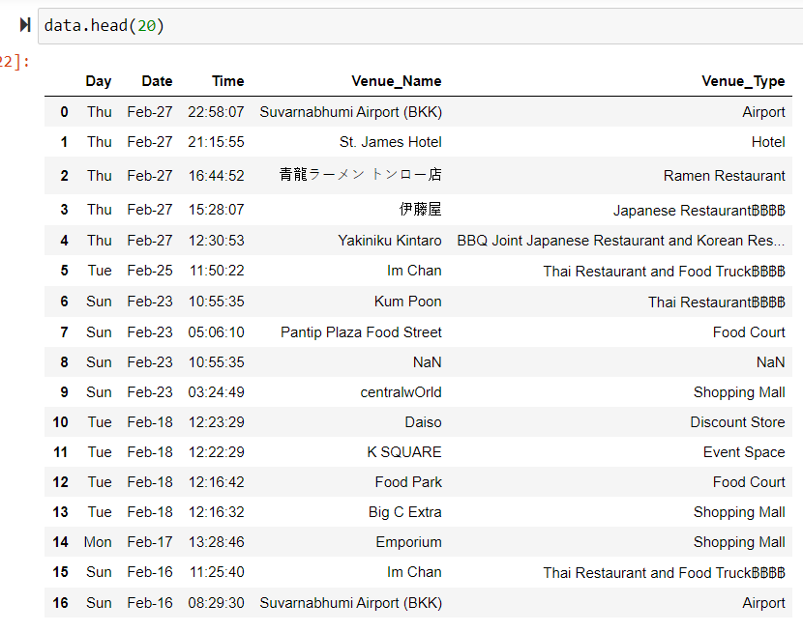
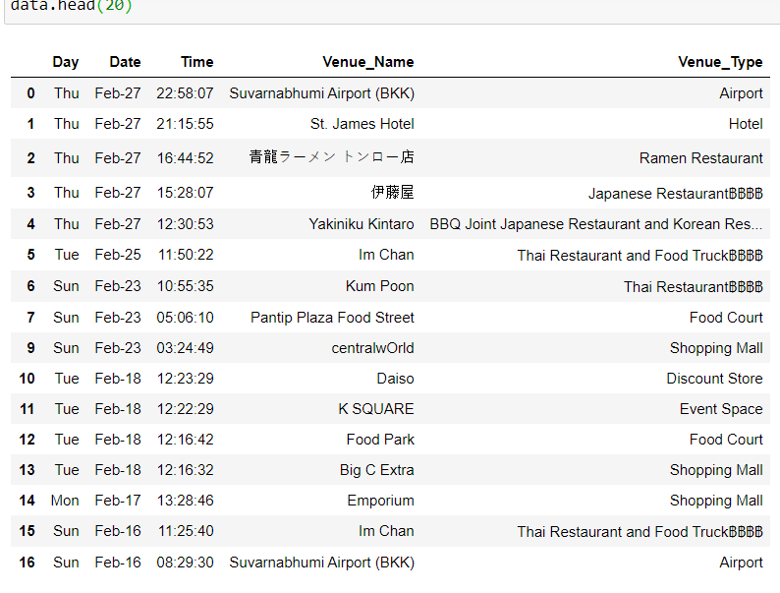
IMPLEMNTATION: Data Pre-Processing
Initial Unprocessed Data
STEP 01: Deleting Rows with Null Values

Slide 14
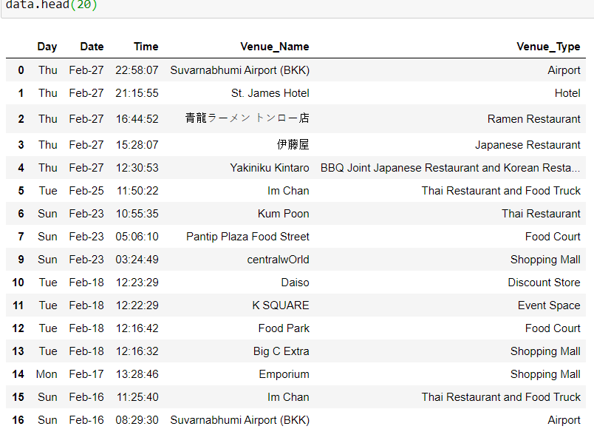
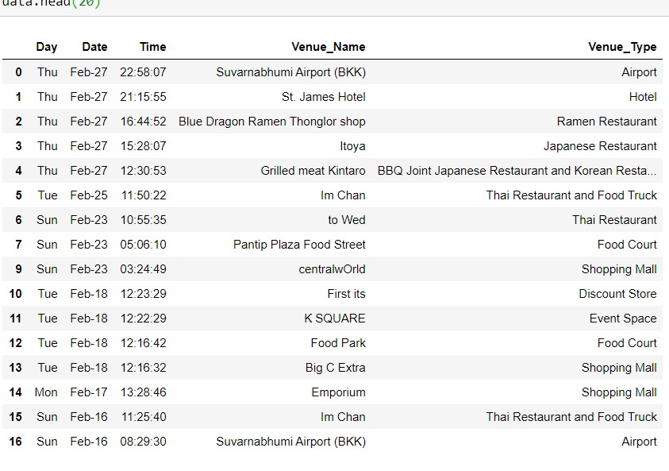
IMPLEMNTATION: Data Pre-Processing
STEP 03: Removing Special Characters
STEP 03: Translating to English

Slide 15
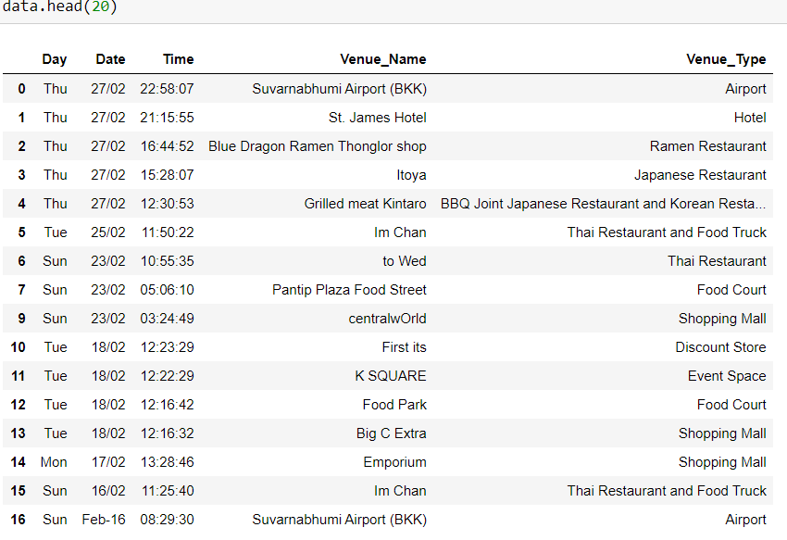
IMPLEMNTATION: Data Pre-Processing
STEP 05: Converting string date to date-time Format

Slide 16
Data Engineering
One major challenge for summarizing the activity preferences of Asian and Western is that there are numerous types of venues in the collected data. So, we have categories the venues into eight different categories those are as follows:
1. | Travel & Transportation | Airport, Train Station, bus station, metro station, Hotel.
2. | Art & Entertainment | Art Gallery, Art Museum, Cultural Centre, Concert Hall, Stadium, Movie Theatre, Theme Park, Zoo, Multiplex
3. | Events | Market, conference, festival, Road
4. | Food | American Restaurant, Asian Restaurant, Italian Restaurant, Japanese restaurant, Mexican Restaurant, Coffee shop, BBQ Joint restaurant, Noodle house, Desert Shop
5. | Shop & Service | Shopping Mall, Airport Service, Convenience Store, Departmental Store, Accessories store, Clothing Store, Electronic Store, Massage parlour
6. | Professional & other places | Temple, Buddhist Temple, Residential Building, Convention centre, Medical centre, Office, Church
7. | Nightlife Spot | Lounge, Bar, night market, nightclub.
8. | Outdoors & Recreation | Athletic sports, Golf Course, beach.

Slide 17
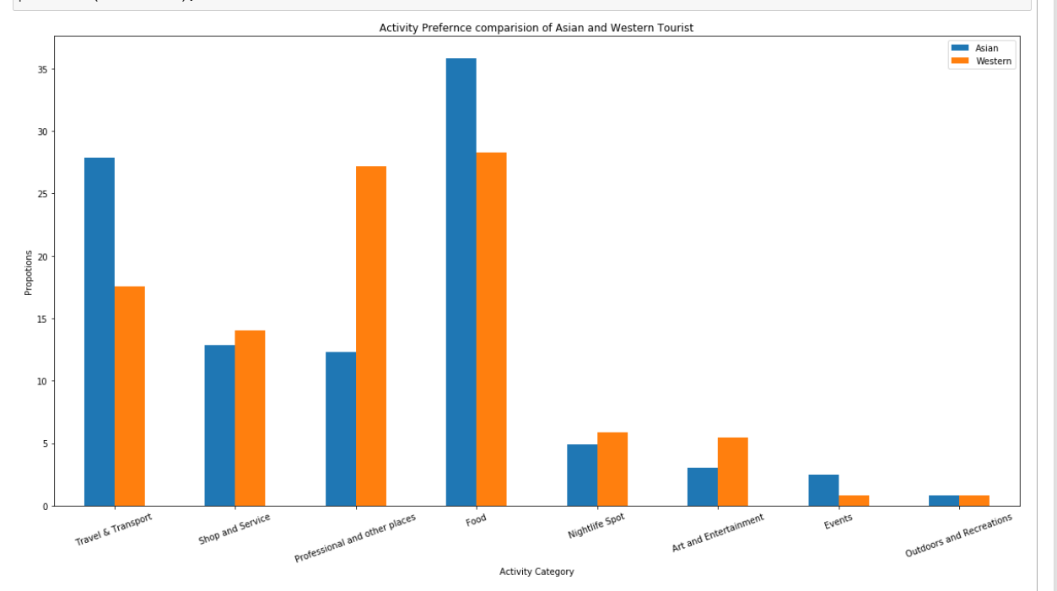
ANALYSIS AND FINDINGS
1. Activity Preference Analysis of Asian Vs Western tourists.

Slide 18
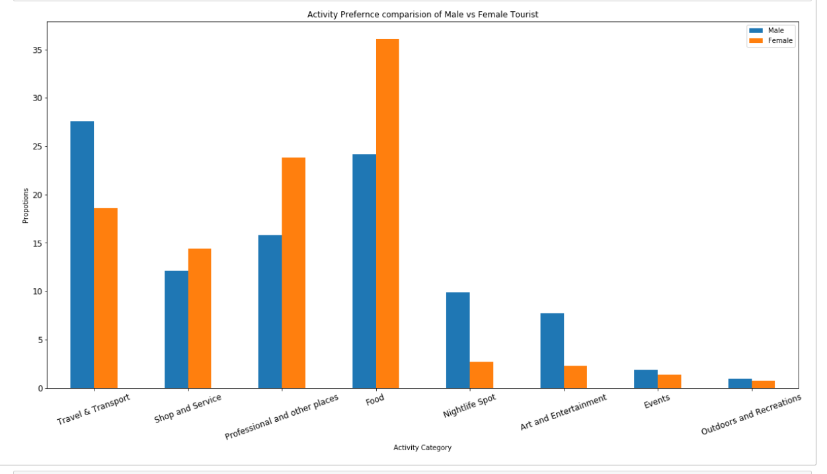
2. Activity Preference Analysis of Male v/s Female tourists

Slide 19
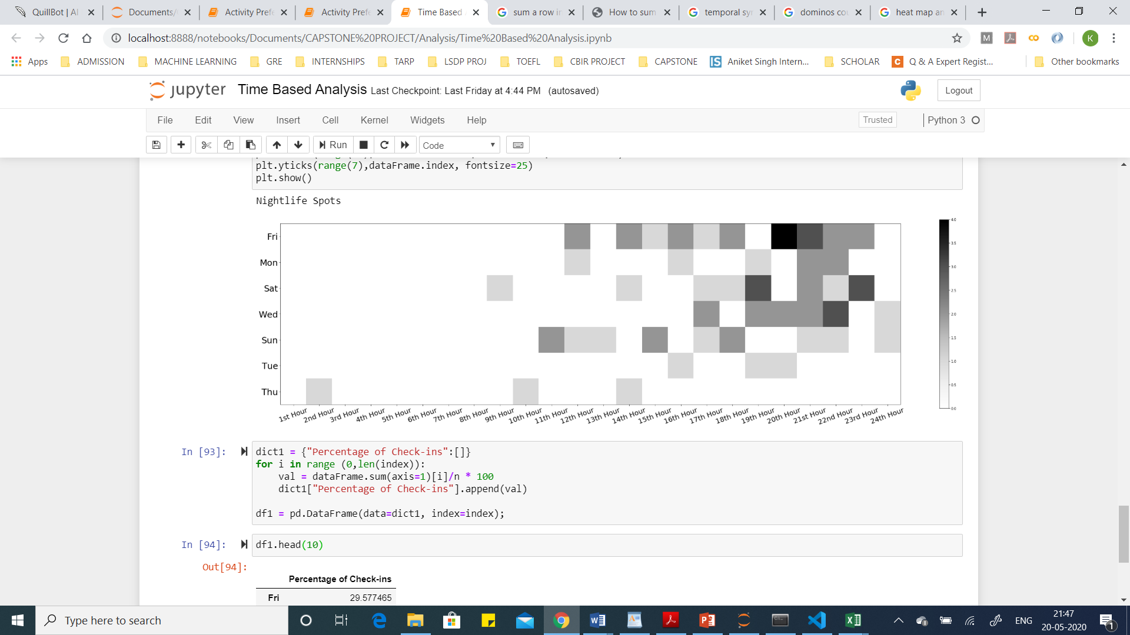
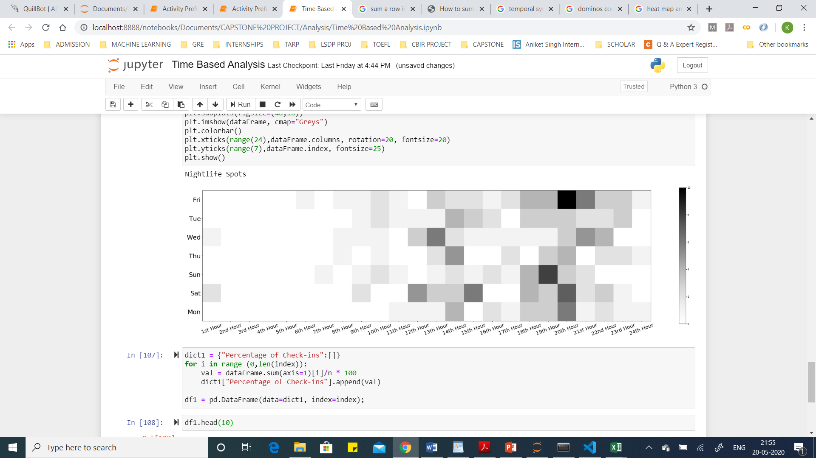
3.1 Temporal Analysis of Nightlife Spots
Day | Proportion of Check-ins
Fri | 29.577465%
Mon | 9.859155%
Sat | 18.309859%
Wed | 16.901408%
Sun | 16.901408%
Tue | 4.225352%
Thu | 4.225352%
3.2 Temporal Analysis of Restaurants
Day | Proportion of Check-ins
Fri | 20.434783%
Tue | 13.478261%
Wed | 13.913043%
Thu | 10.000000%
Sun | 12.608696%
Sat | 17.826087%
Mon | 11.739130%

Slide 20
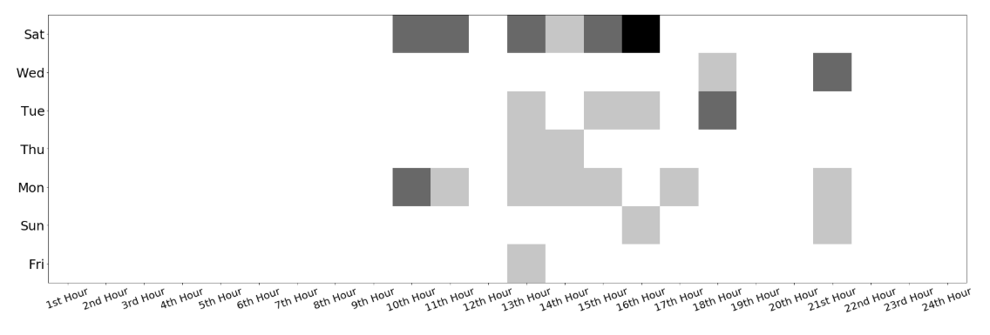
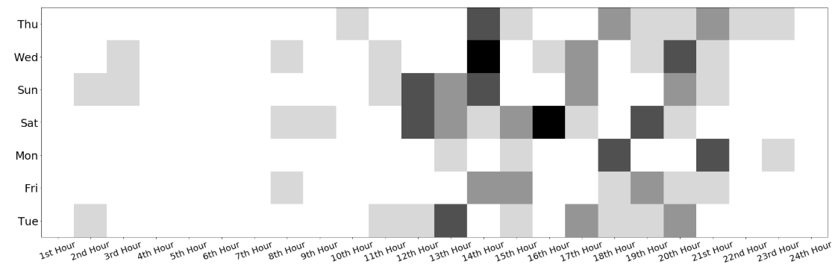
3.3 Temporal Analysis of Temples
Day | Proportion of Check-ins
Sat | 36.363636%
Wed | 9.090909%
Tue | 15.151515%
Thu | 6.060606%
Mon | 24.242424%
Sun | 6.060606%
Fri | 3.030303%
3.4 Temporal Analysis of Shopping Malls
Day | Proportion of Check-ins
Thu | 13.684211
Wed | 15.789474
Sun | 16.842105
Sat | 20.000000
Mon | 9.473684
Fri | 10.526316
Tue | 13.684211

Slide 21
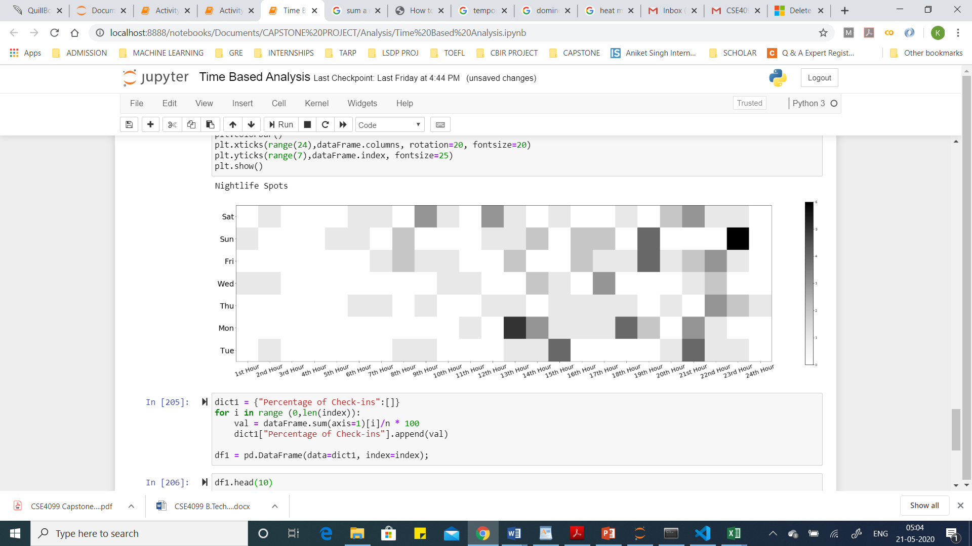
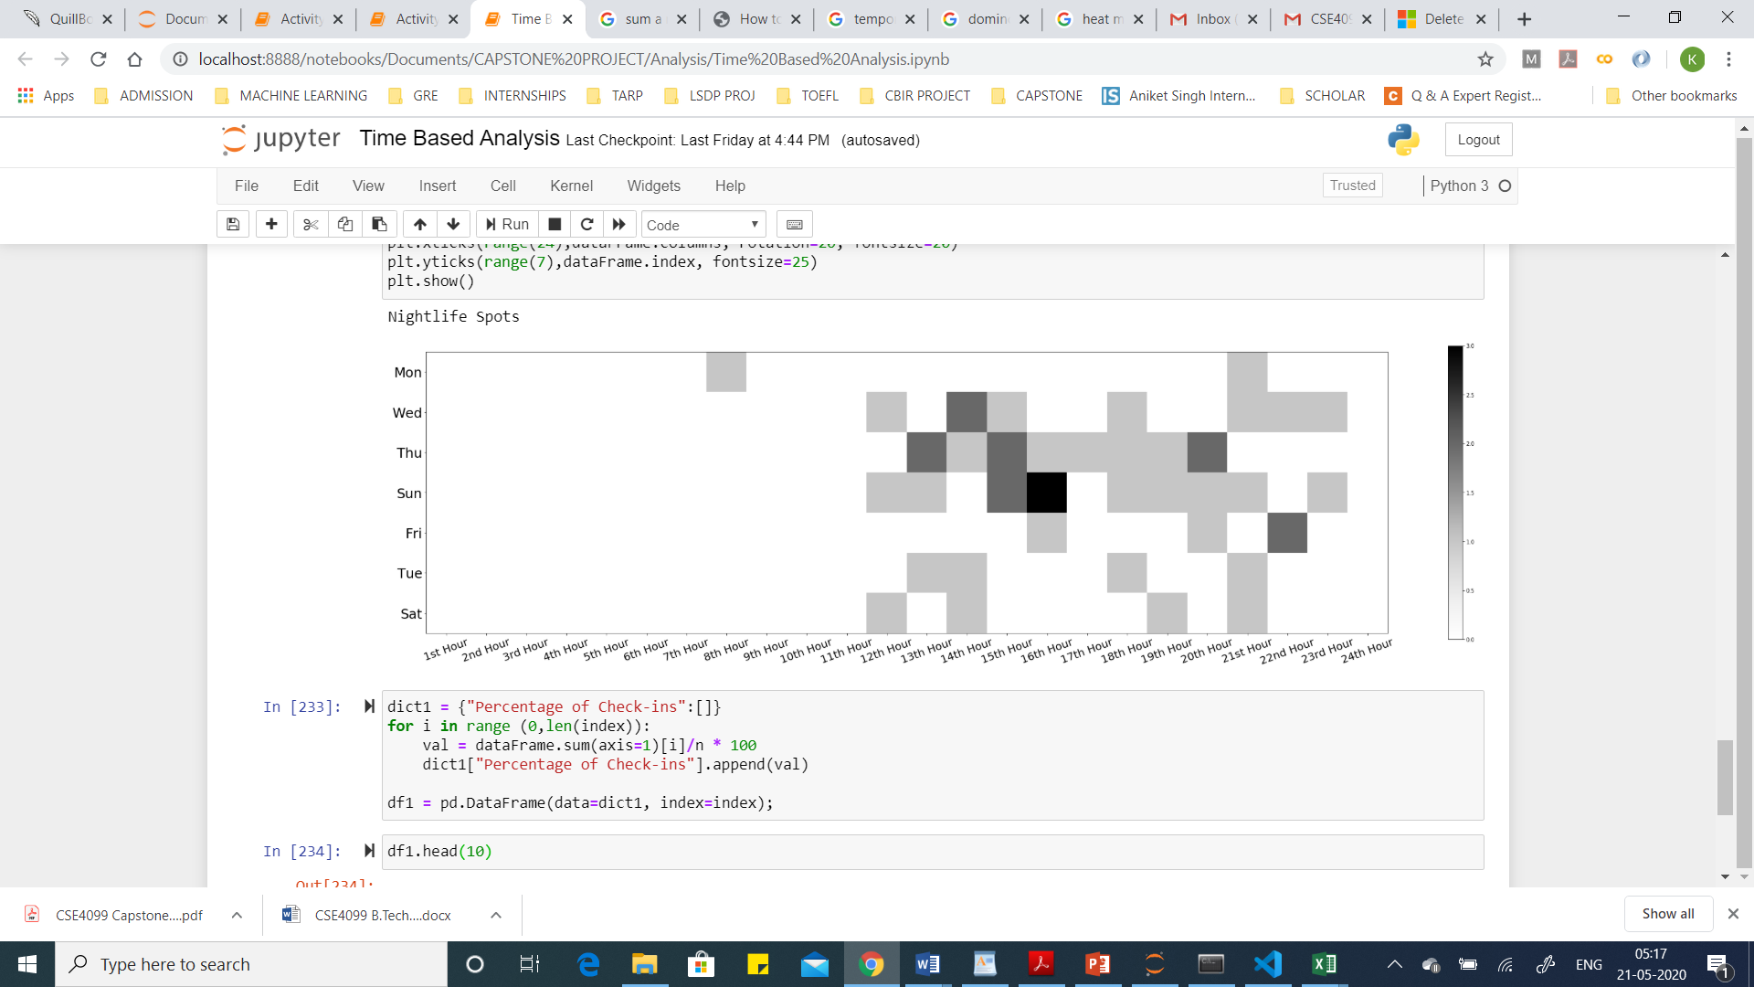
3.5 Temporal Analysis of Airport
Day | Proportion of Check-ins
Sat | 15.151515
Sun | 17.424242
Fri | 16.666667
Wed | 9.848485
Thu | 12.121212
Mon | 16.666667
Tue | 12.121212
3.6 Temporal Analysis of Coffee Shops
Day | Proportion of Check-ins
Mon | 4.347826
Wed | 17.391304
Thu | 23.913043
Sun | 26.086957
Fri | 8.695652
Tue | 8.695652
Sat | 8.695652

Slide 22
REFRENCES
[1] Vu, Huy Quan, et al. "Tourist activity analysis by leveraging mobile social media data." Journal of travel research 57.7 (2018): 883-898.
[2] Vu, Huy Quan, et al. "Exploring tourist dining preferences based on restaurant reviews." Journal of Travel Research 58.1 (2019): 149-167.
[3] Ma, Xu, et al. "Predicting Future Visitors Of Restaurants Using Big Data." 2018 International Conference on Machine Learning and Cybernetics (ICMLC). Vol. 1. IEEE, 2018.
[4] Liu, Shaowu, et al. "Analyzing changes in hotel customers’ expectations by trip mode." International Journal of Hospitality Management 34 (2013): 359-371.
[5] Frechtling, Douglas C. Practical tourism forecasting. Butterworth-Heinemann Ltd, 1996.

Slide 23
THANKYOU

